Slide 1
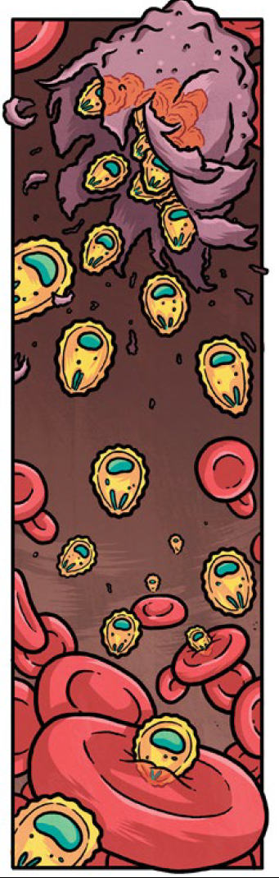
Year 11 Unit 1
Ecological Hazards - Malaria

Slide 2
THINK, PAIR, SHARE 1. What is malaria? 2. Who is at risk of malaria? 3. What type of hazard is it?

Slide 3
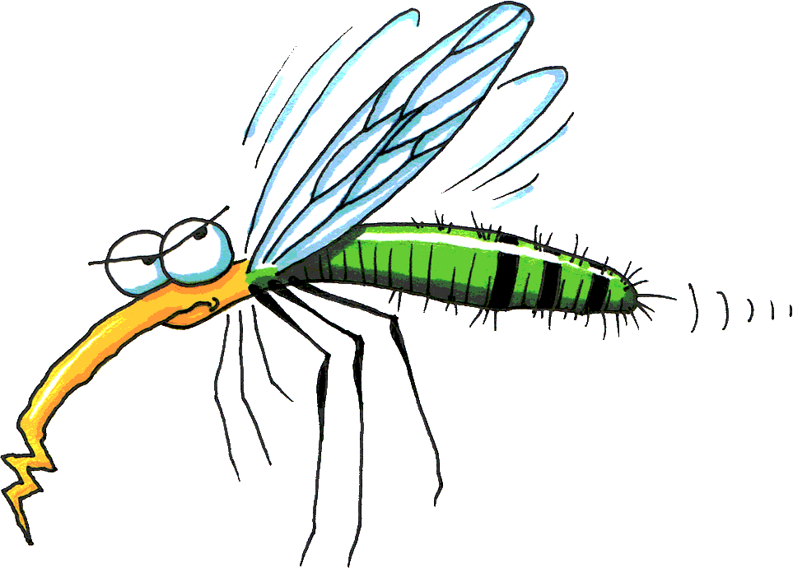
Malaria – Tropical Diseases Depth Study Two Ecological Hazards Unit 1 - GEOGRAPHY
Malaria is a disease caused by parasites that are carried by mosquitoes. Once in the bloodstream, the parasite inhabits the red blood cell (RBC).

Slide 4
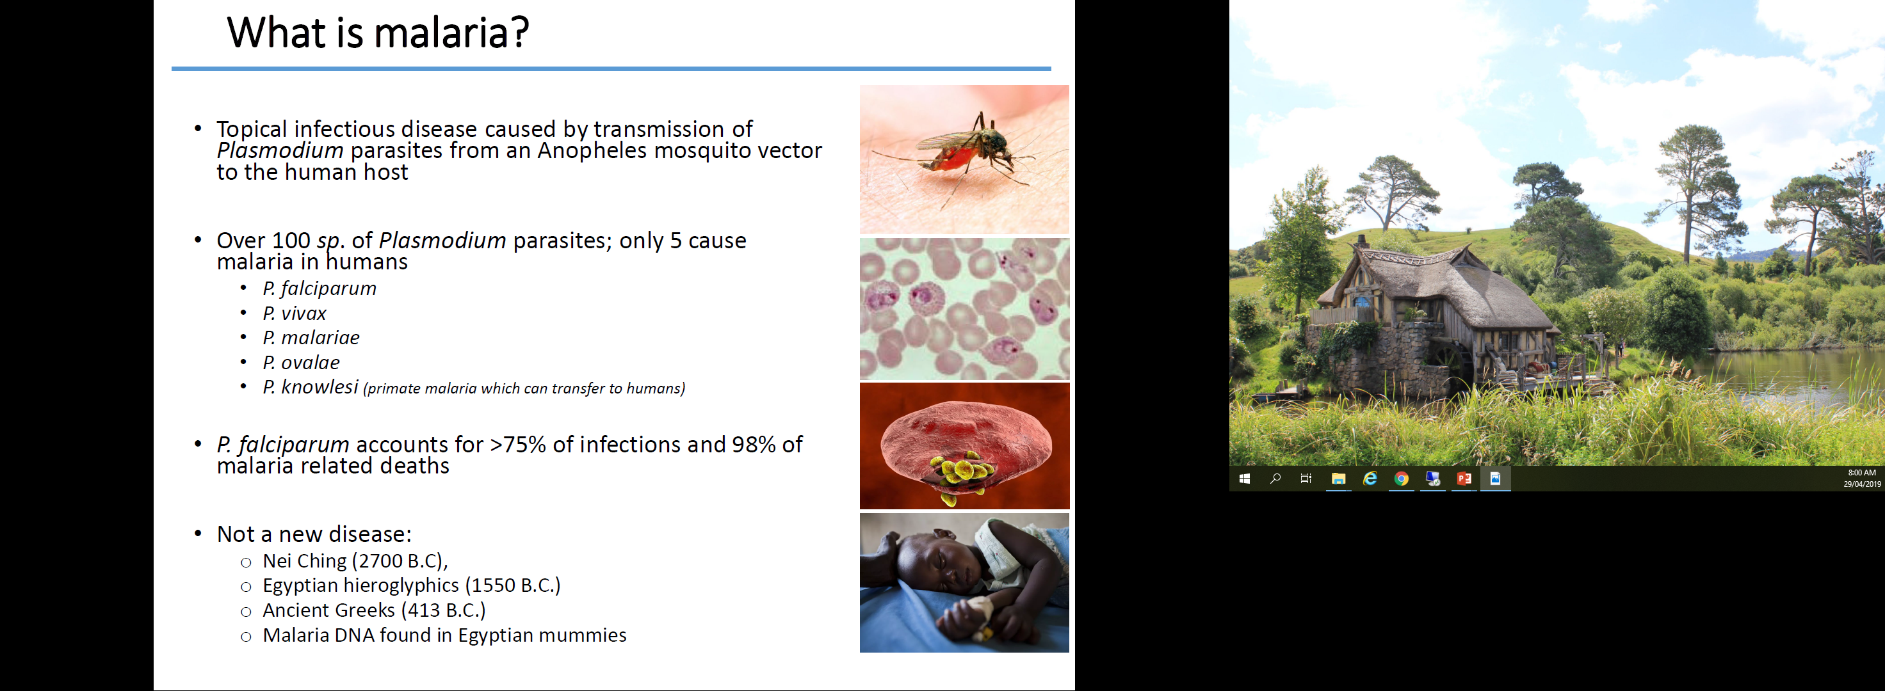

Slide 5
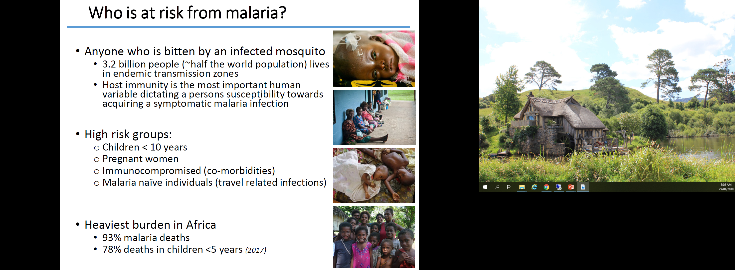

Slide 6
https://www.youtube.com/watch?v=gwYIyjwYluc

Slide 7
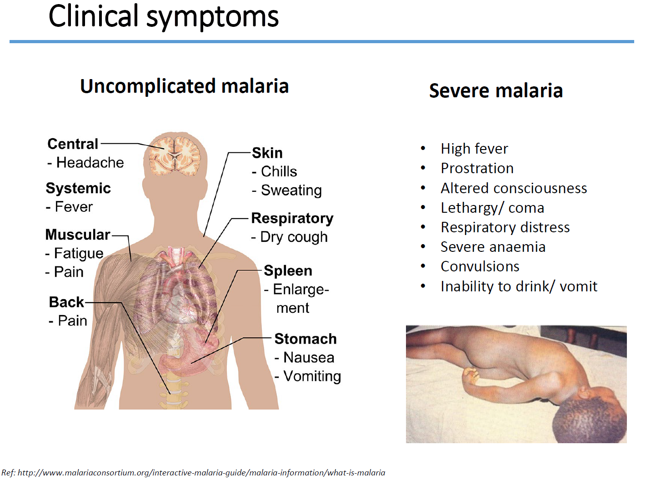
Prostration = severe weakness
Anaemic = reduction of red blood cells
TEXTBOOK:
Read pages 100 – 102 (Section 5.1)
Complete activities 1,2,3 on page 102

